Slide 1

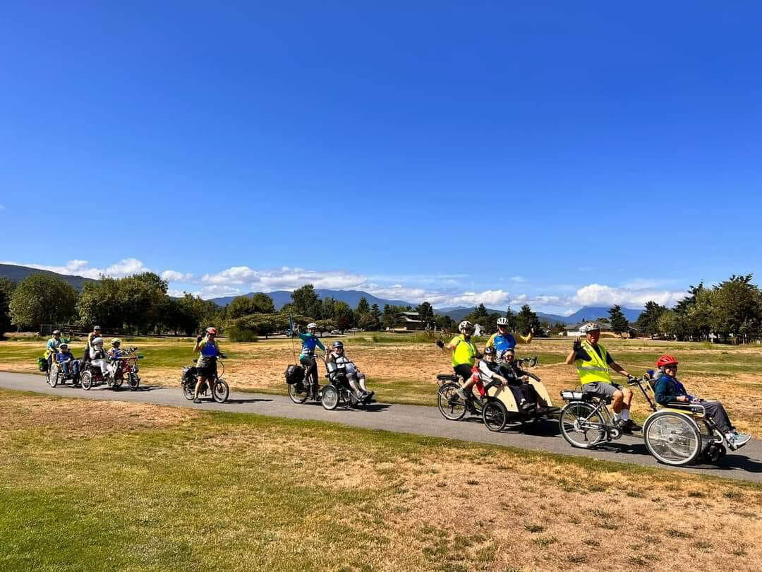
2026 Sequim Wheelers Orientation
Welcome Aboard!
Let’s go around the room …
Please give your name?
How long living in the Sequim area?
How did you find us?
“Come Ride With Us”

Slide 2
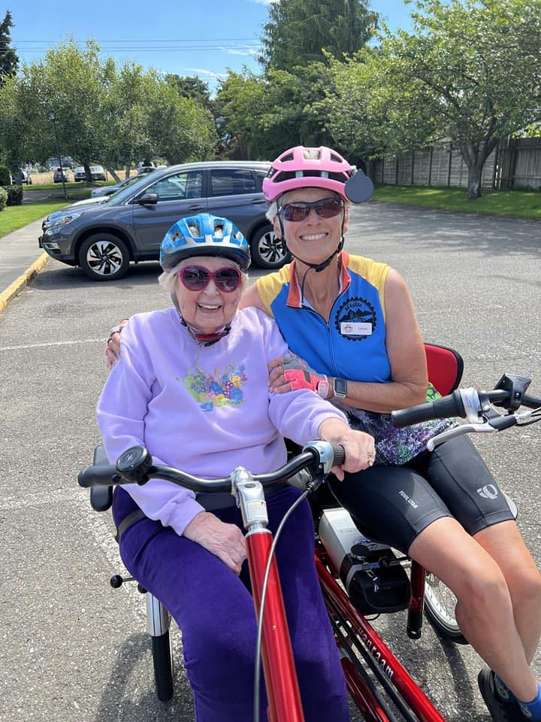
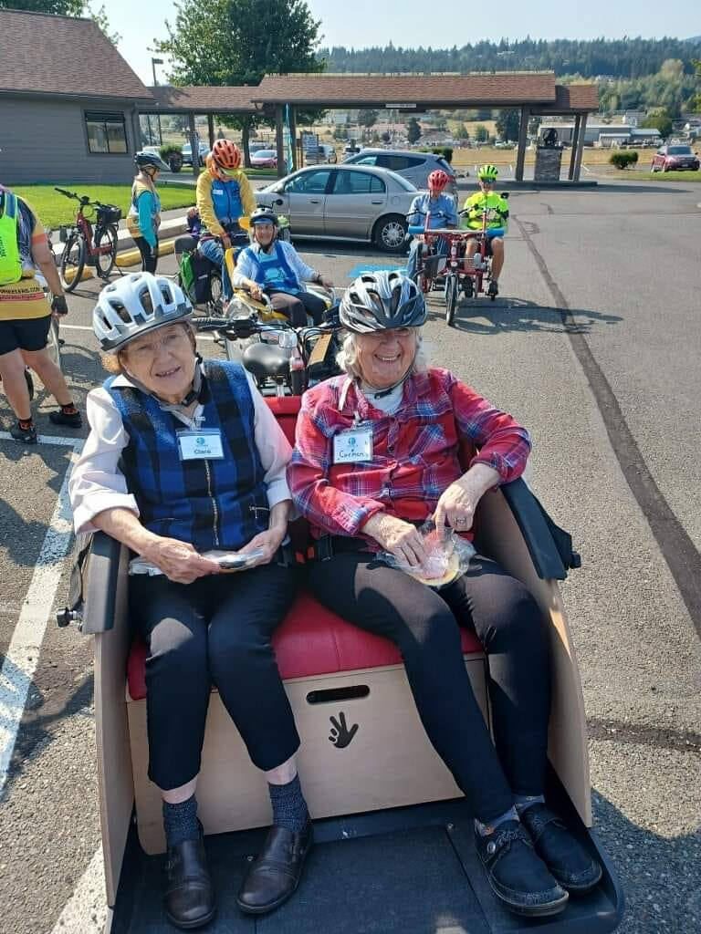
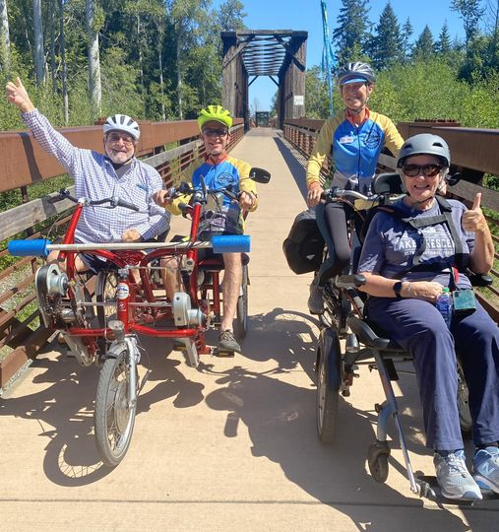
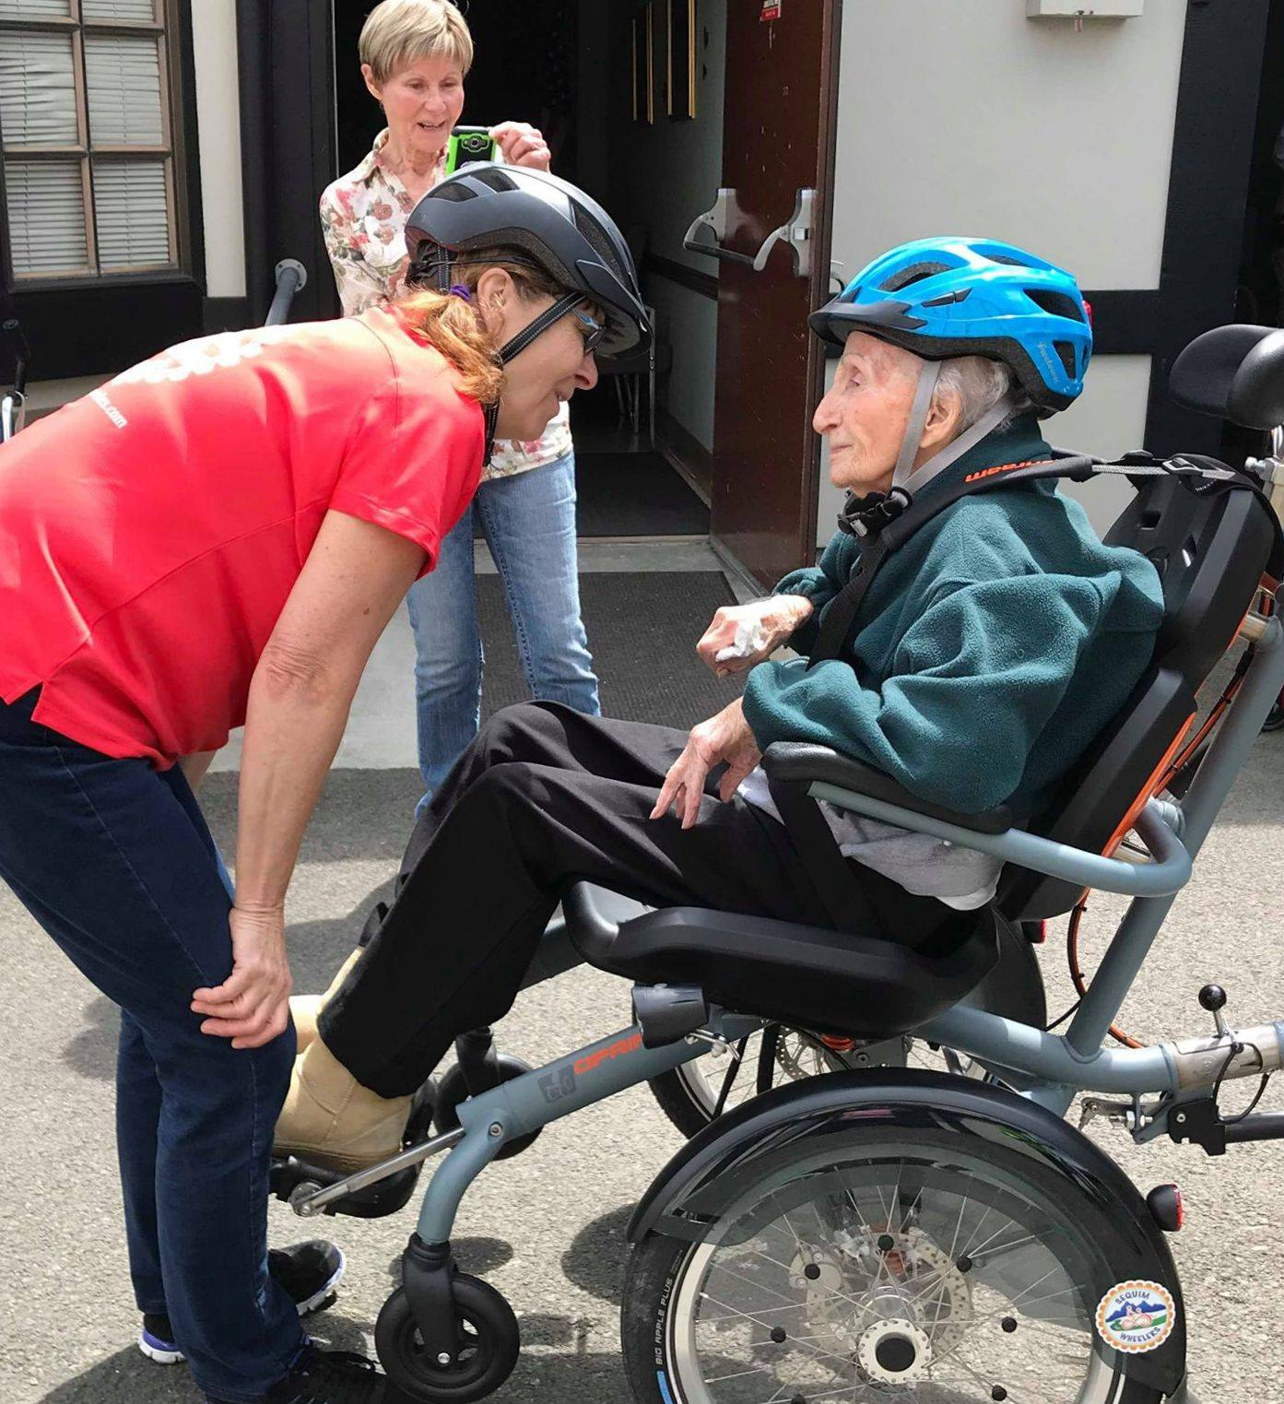
Sequim – Dungeness Valley’s Unique Adaptive Bike Program
Thank you for joining our Team

Slide 3
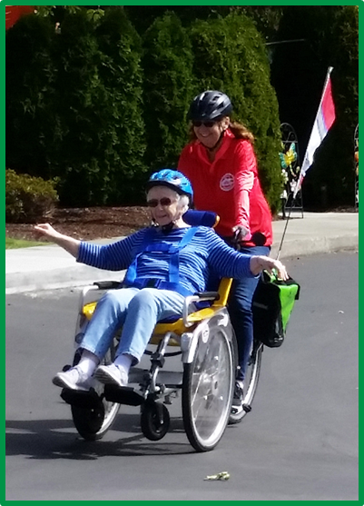
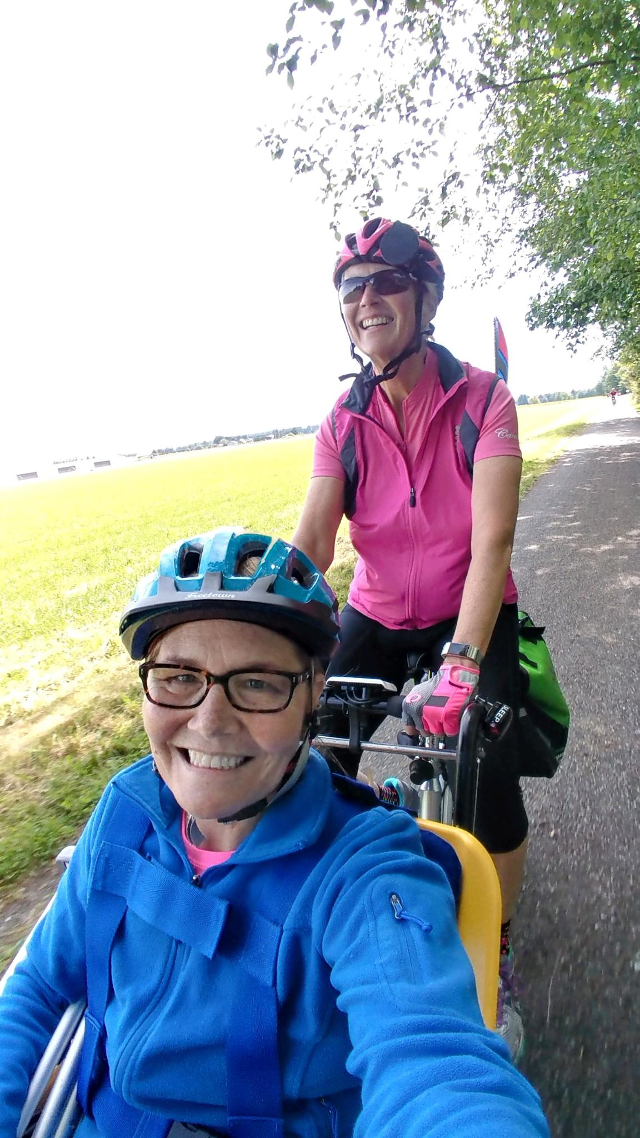
Our Mission and Objectives
Offer free-of-charge wheelchair bike rides for folks that cannot ride a bike on their own.
Build a more inclusive community for people of all ages and abilities.
Provide an opportunity for fresh air, a sense of adventure, and sunshine for both wheelers and our volunteers.
Treat everyone with kindness and respect.
Ensure everyone has a safe, fun and memorable experience.
The joy of being outside
It’s a fun adventure

Slide 4
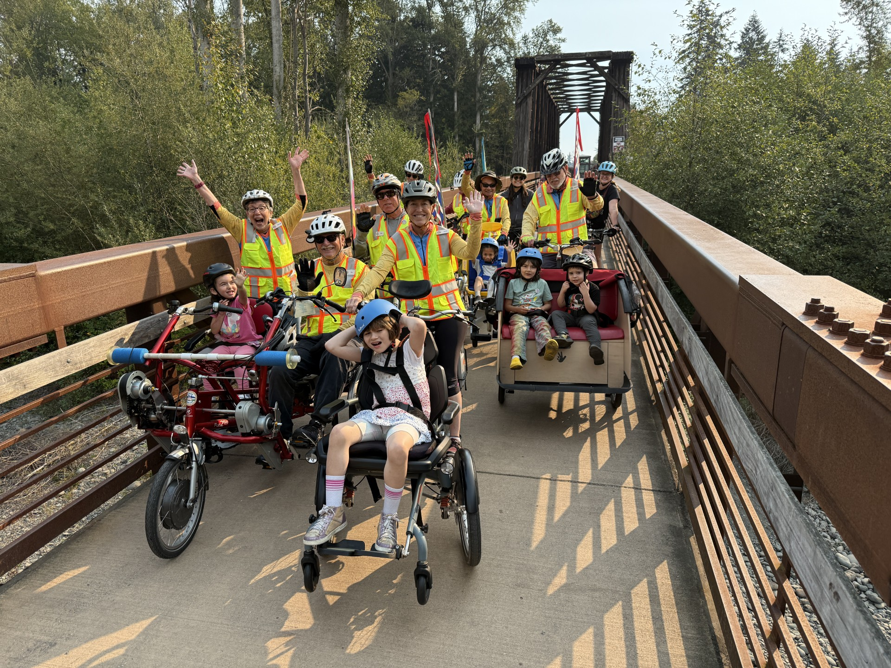
Sequim Wheelers (Started 2018 – 9th Season)
501 C 3 nonprofit organization - donations are now tax deductible “above the line” starting in 2026 (don’t have to itemize deductions).
Governed by a 9 – 11 member Board of Directors.
Board meets monthly at The Gathering Place in Sunland – 4 PM on the 1st Tuesday (Jan – Oct).
64 Volunteers +8.5% – 227 Wheelers +14.6% - 481 Bike Rides +19.7%.
Independent Affiliate - International “Cycling Without Age” organization – 3,050 Chapters in 41 Countries around the World.
2026 Theme is “Leave a Legacy” (Succession Planning to make sure people and resources are in place to carry on for future generations).
Salish Coast Elementary School Kids

Slide 5
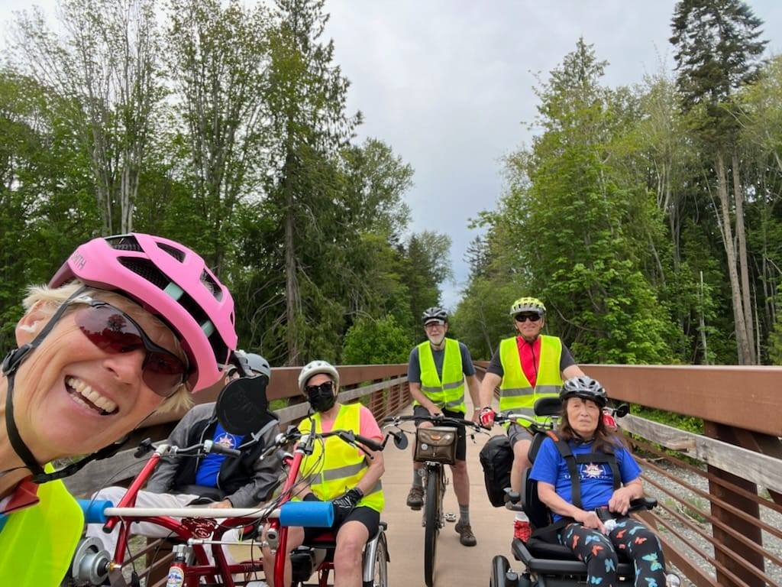
What to Expect for the 2026 Season
Four new bikes that were manufactured by Van Raam in the Netherlands (same electronics to operate).
New volunteers will be trained on five different types of bikes over three 2.5 hour training sessions.
Nice mix of bikes for the wheelers and volunteers.
Remembering that everything you do with the Sequim Wheelers is voluntary, we do anticipate having multiple special event opportunities to enhance your experience.
Examples include: 1) booth at the Farmer’s Market, 2) ride in the Irrigation Festival parade, 3) Ice Cream Social at the Grange, 4) Music in the Park, 5) Ian’s Sea to Sound Ride & more.
Welcome Aboard New Volunteers!

Slide 6
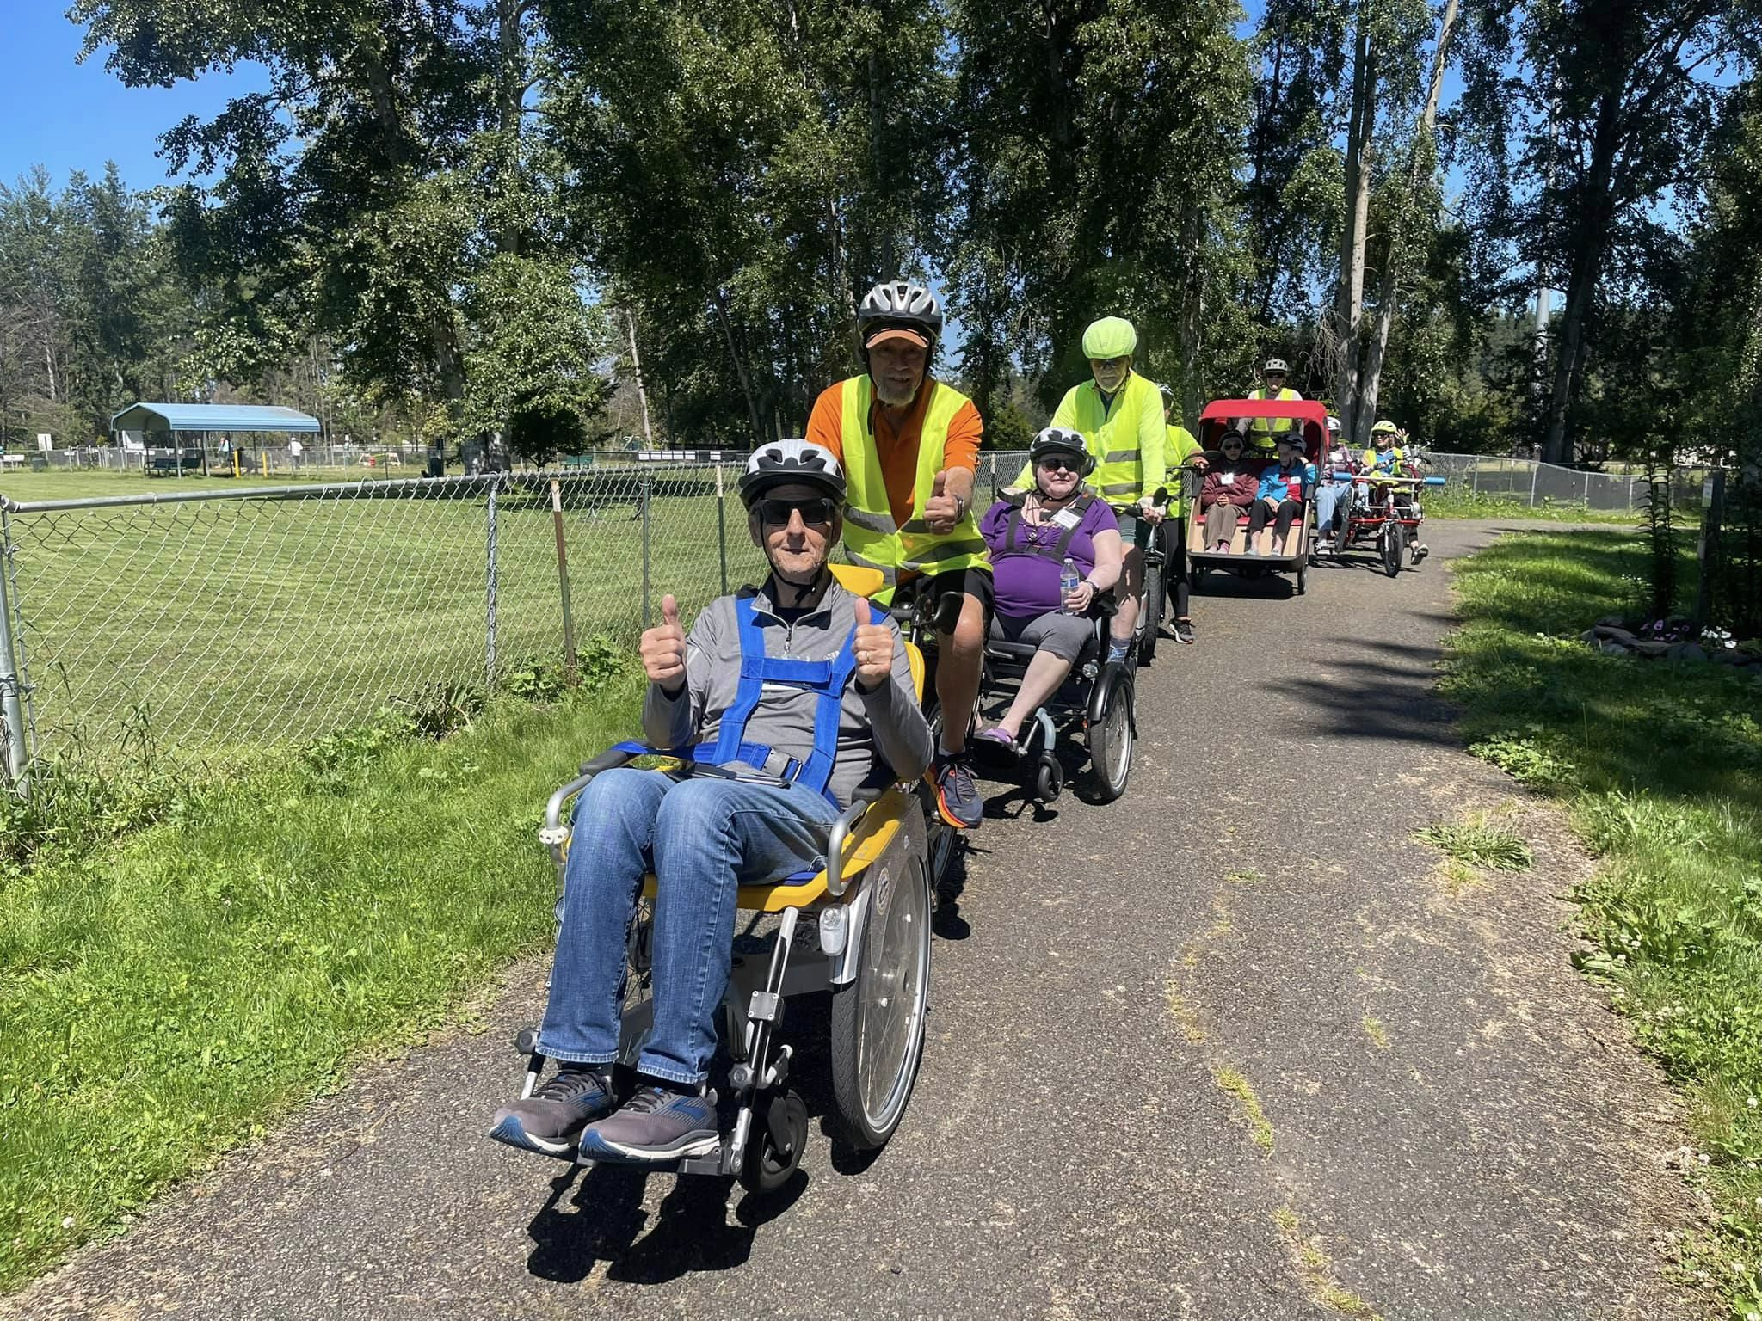
Who We Serve
Avamere Olympic Rehab Clallam Mosaic | Dungeness Courte Memory Care Fifth Avenue Independent Living Friends Place Friends Together Minsky’s Place (Veterans) Sequim Bay Post Acute Sherwood Assisted Living Sinclair Place The Cottages of Sequim Book-a-Ride Program (website)

Slide 7
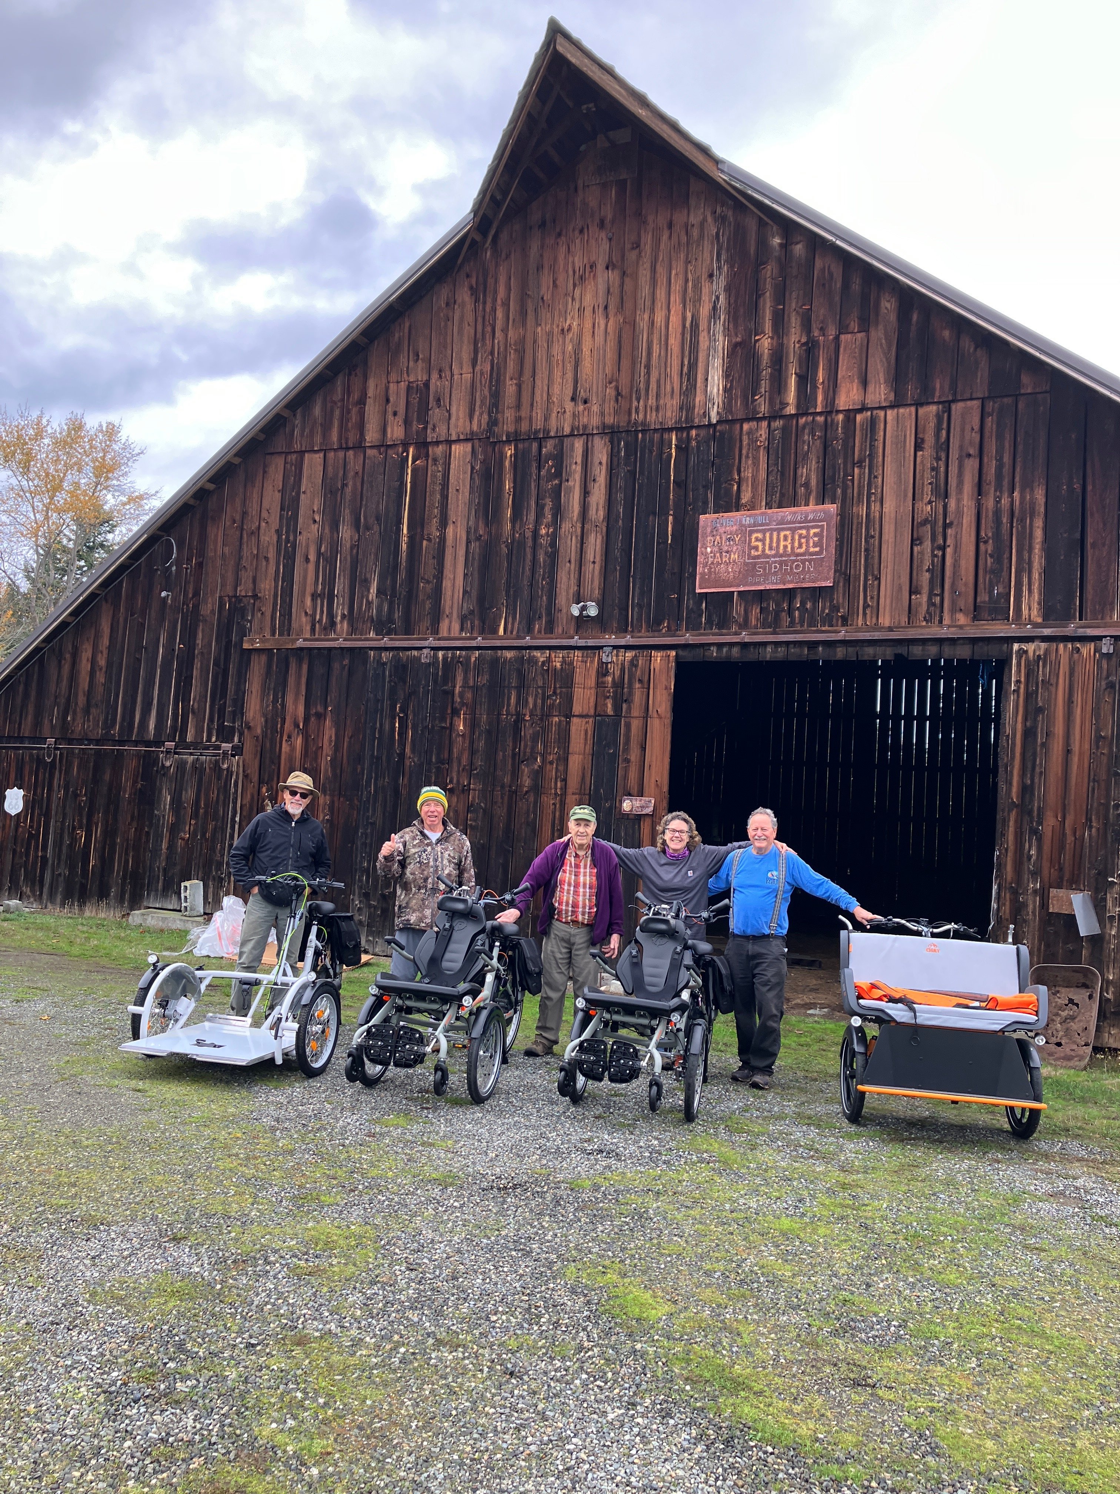
Bike Storage Location
Our host Nancy has graciously allowed our bikes to be stored on her property near the Dungeness River Nature Center giving us quick and easy access to the Olympic Discovery Trail (watch out for her wellhead).
Vehicle parking is available west of the barn you see in the adjacent picture … your bike if not used during the ride should be inside the locked storage shed.
We pickup the wheelers at some of our riding partners that are located conveniently on the Olympic Discovery Trail while others meet us at the Dungeness River Nature Center to start and end their rides.
Four new bikes from the Netherlands arrived in Sequim November 13, 2025

Slide 8
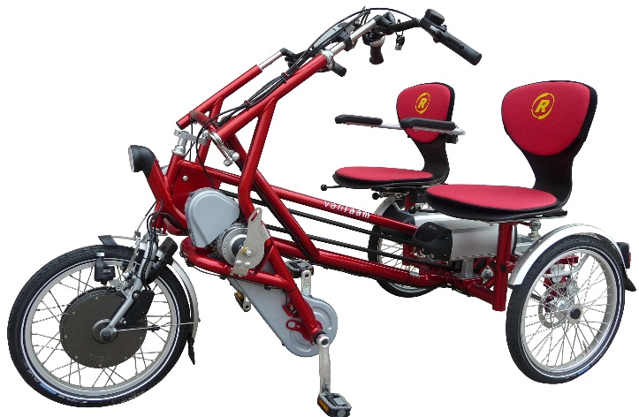

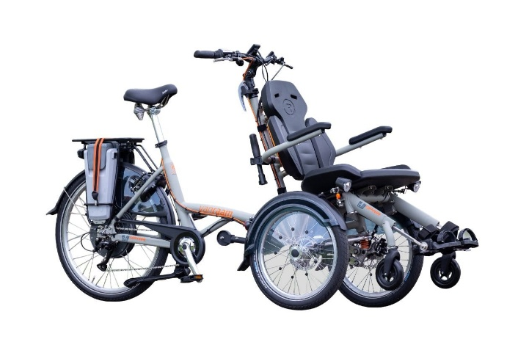
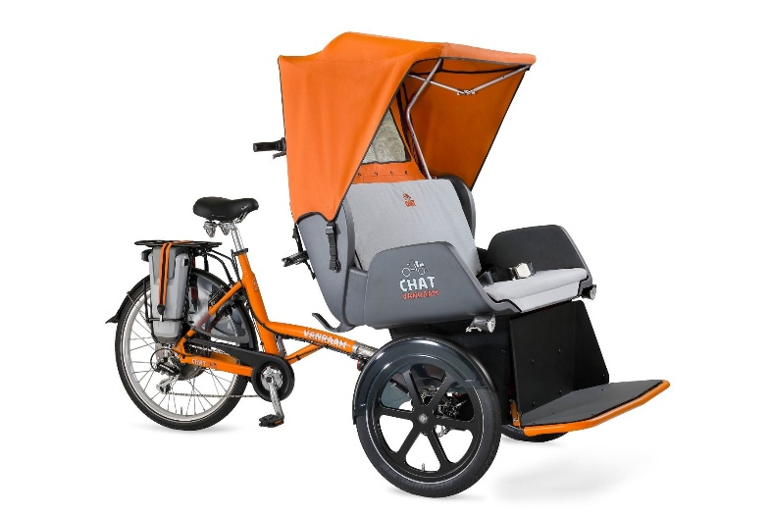
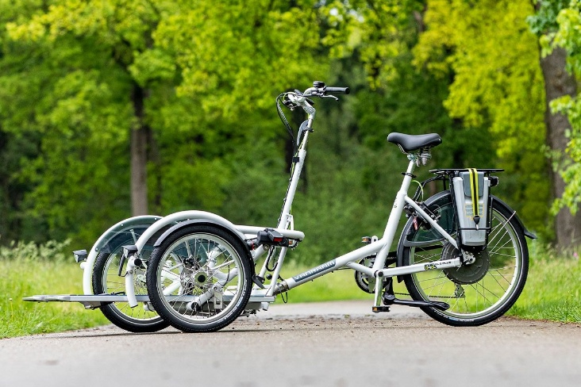
2026 Season Bike Fleet
2 Opairs
Trishaw
Fun2Go
Chat
VeloPlus

Slide 9
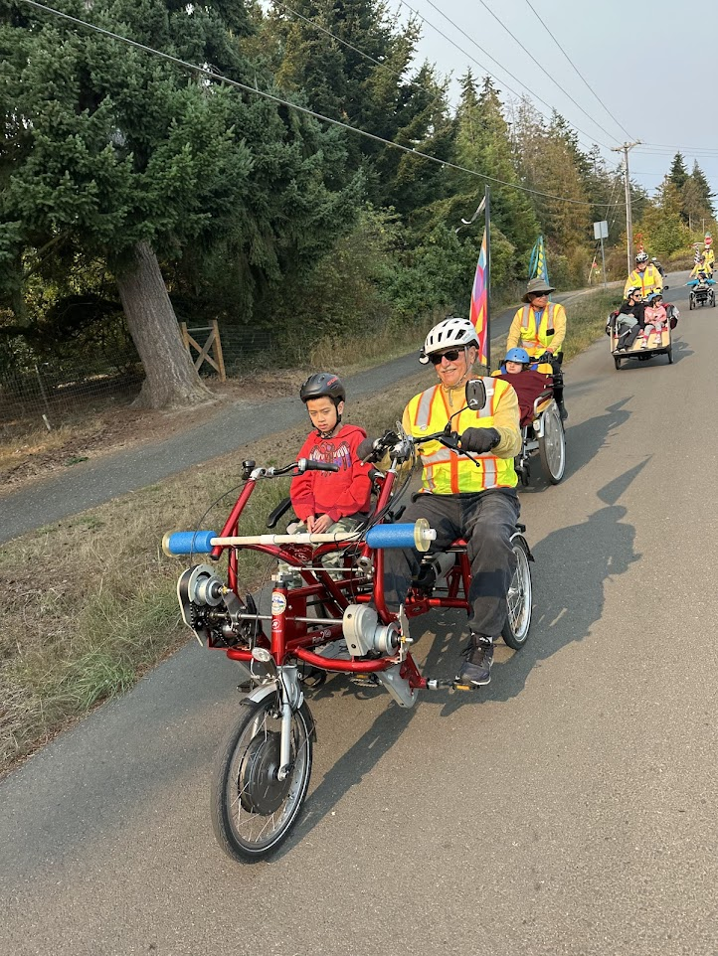
Your Ride Team “The POD”
Ride Leader (may be a Pilot or Safety – primary communicator and decision maker for the POD).
Pilot (on-bike operator – please stay together as a “POD” - safety is paramount in all your decisions).
Safety (escort on your own bike – crosswalk traffic control, potential hazards & comfort of the wheeler).
Wheeler (aka passenger – could be developmental or intellectually disabled, have a memory loss issue or they just want to go for a bike ride and they’re not comfortable riding a bike on their own).
Activity Directors, Relatives & Caregivers are welcome after completing a waiver form.
We’re entrusted with some precious cargo

Slide 10
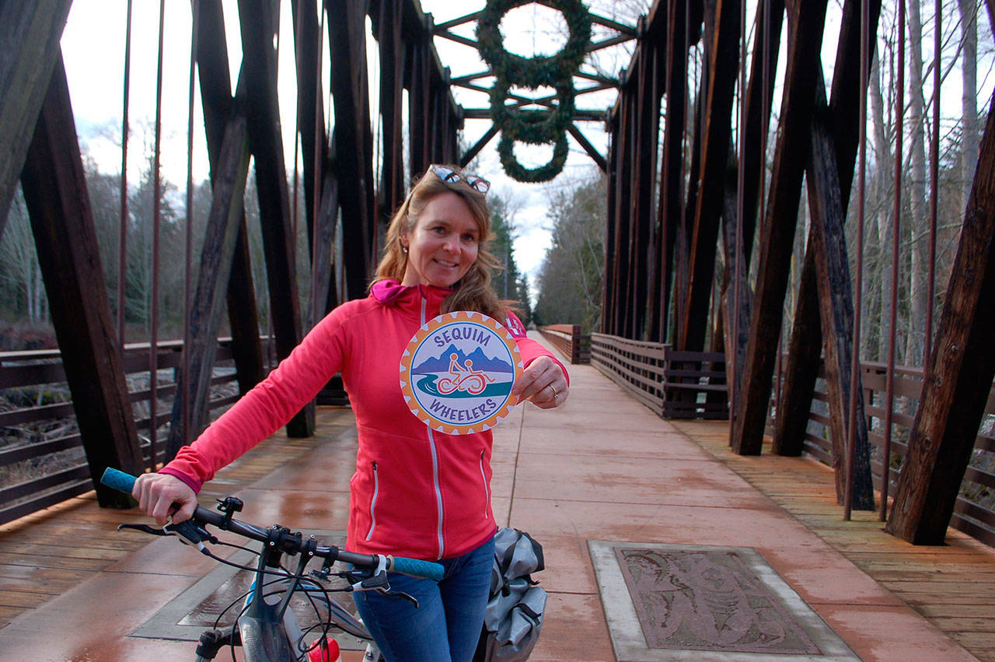
2026 Important Scheduling Information
New Volunteer Orientation – April 18th (Please review your training packet prior to your first Training Session).
New Volunteer Training – Expect to see three 2.5 hour training sessions for your signup posted on the SignUp Genious website.
New Volunteers must complete all three 2.5 hour training sessions before signing up to pilot or safety rides listed on SignUp Genius (best to wait on training until later in the year when you’re ready to ride on a regular basis, if necessary).
Scheduled Ride Season Starts on Memorial Day May 25th.
Scheduled Ride Season Ends on Friday October 16th (tentative date for the Volunteer Appreciation Event at the Dungeness River Nature Center is Thursday October 15th – recap season plus dinner).
Founder and Board Member Emeritus Nicole Lepping

Slide 11
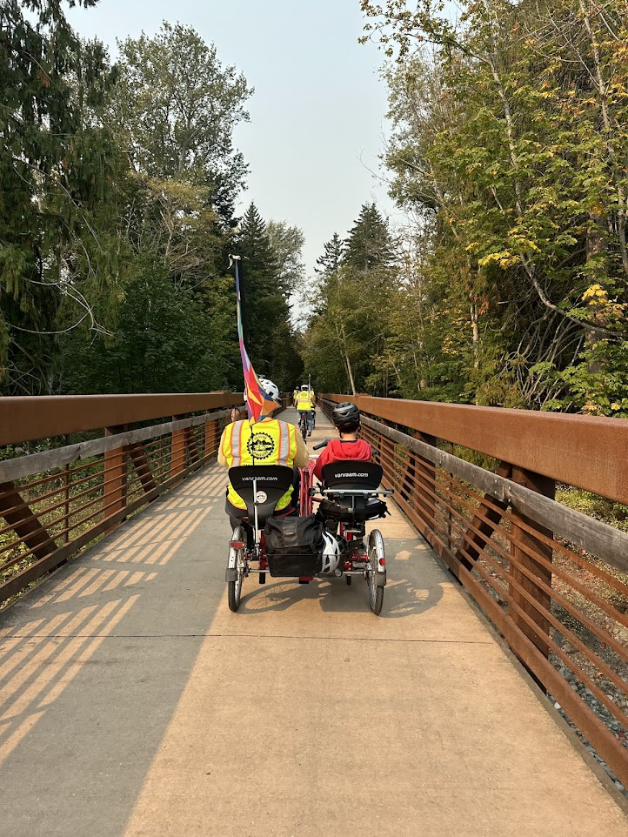
List of Training Documents Available
Hand Signals
Rules of the Road
FAQs
Interpersonal Skills
Memory Loss Issues
Safety Responsibilities
Signing Up for a Ride
“Off we go …”

Slide 12
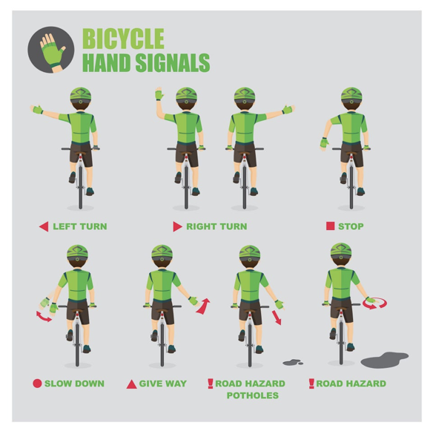

Slide 13
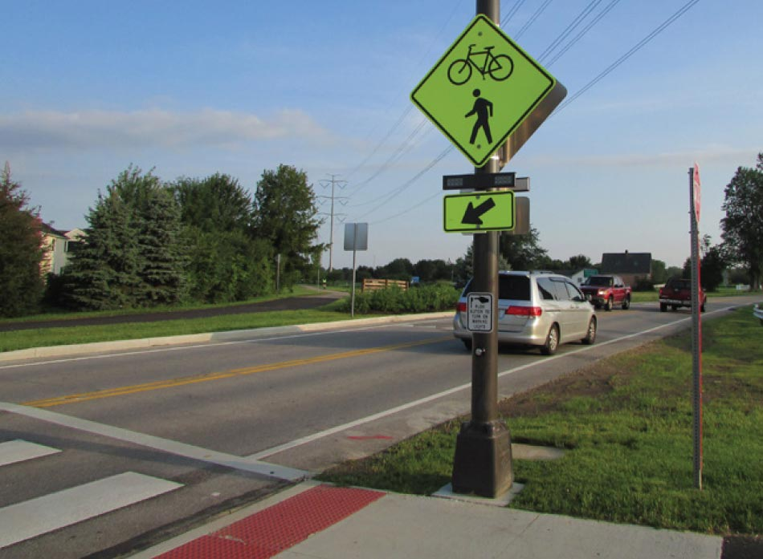
Rules of the Road
Safety is our #1 Priority
Safety features applicable to all volunteers, wheelers and “ride alongs”:
Waivers (certifies weight limits also).
Helmets (no helmet, no ride).
Harness / Seat Belt (when appropriate).
Cell phones (Ride Leader and at least one other volunteer … only used in an emergency and for ride pictures).
Crosswalk Safety Flags & Flashing Lights.
Our dream for the ODT crossing at Carlsborg Road

Slide 14
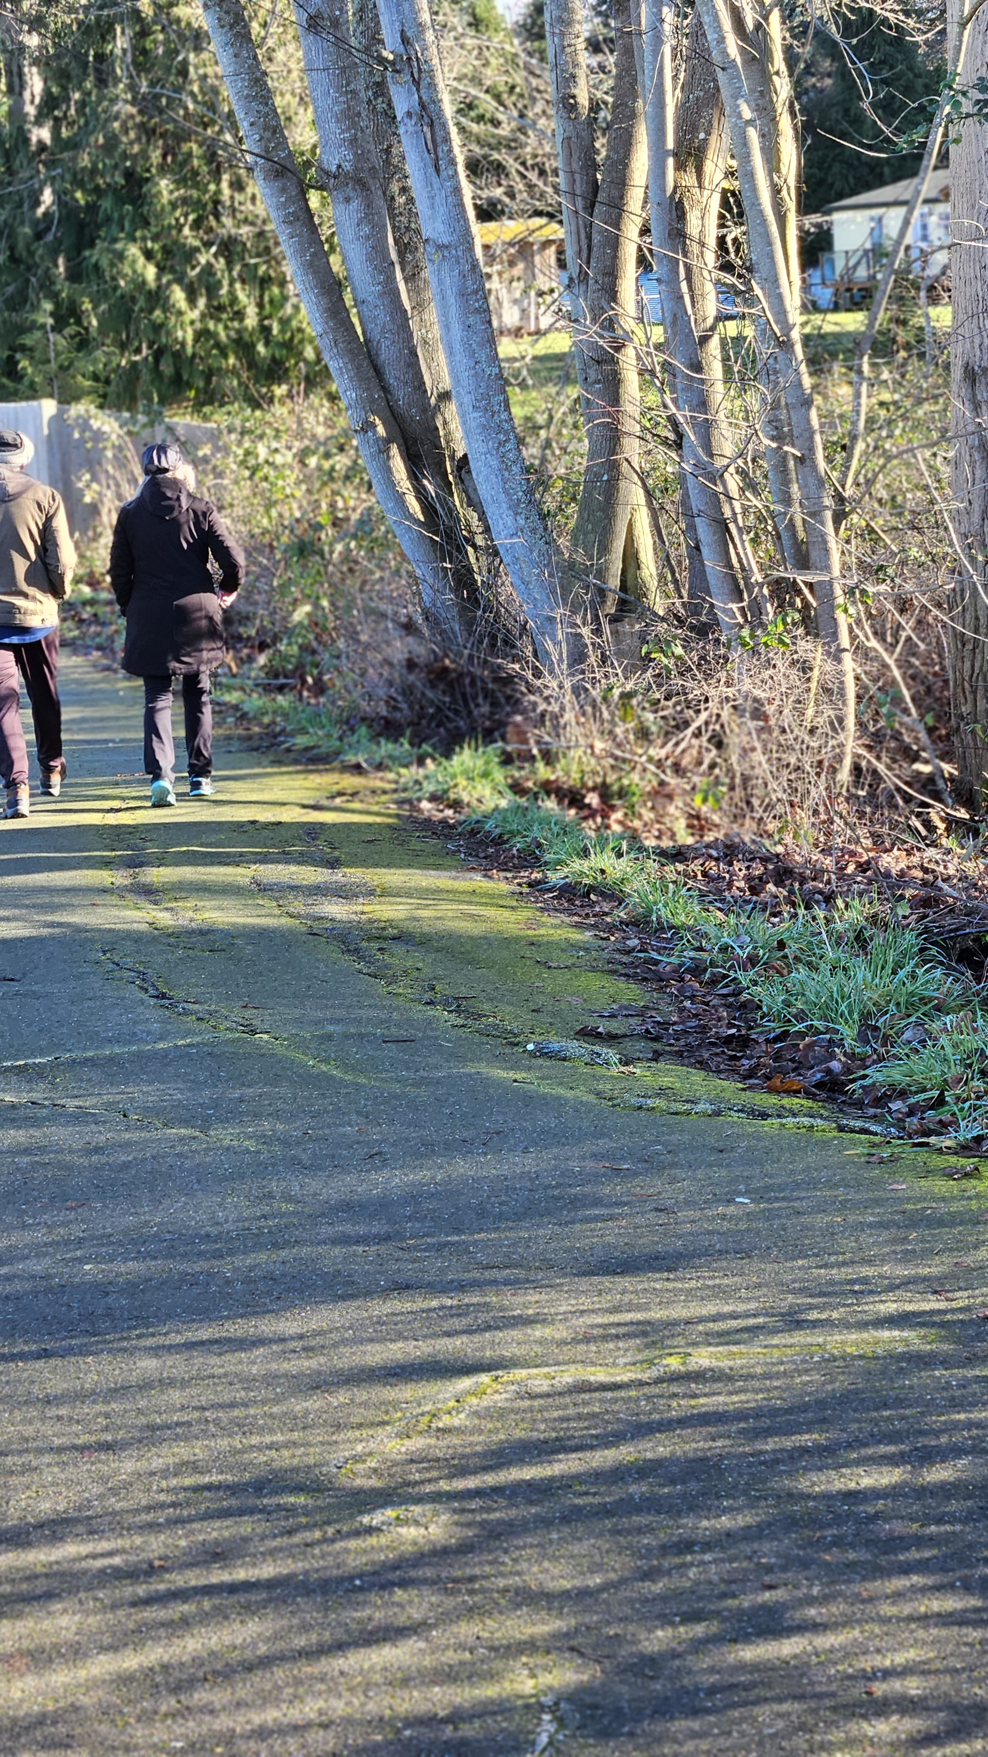
Rules of the Road Highlights #1
We’re fortunate to have the Olympic Discovery Trail (however, we all need to use caution to stay clear of drop-offs, avoid root bumps and watch out for pot holes).
The Sequim Wheelers travel using the “POD” concept (this means to stick together with one leader … allows for better safety when crossing intersections plus quick changes when necessary … adds a sense of teamwork).
Bike speeds should be no more than in the 8 – 9 MPH range set consistently by the Lead Safety (slow down when necessary to keep the POD together).
Avoid potential danger and slow down when necessary … no rush!

Slide 15
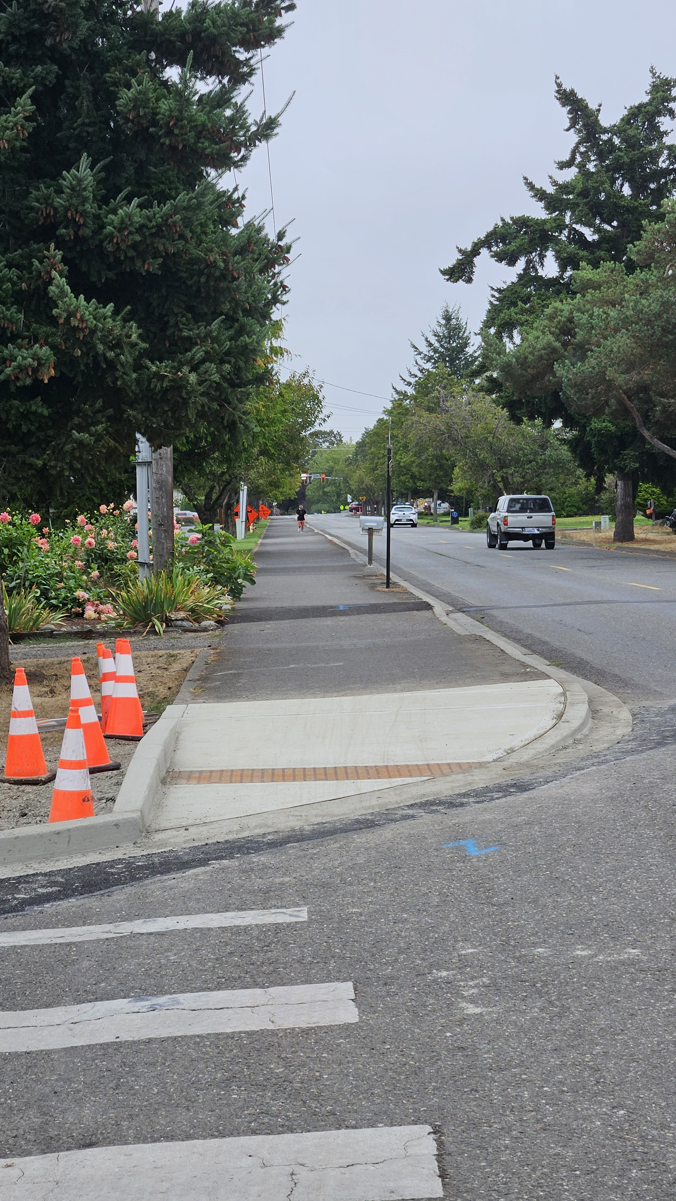
Rules of the Road Highlights #2
Higher traffic road crossings require certain procedures to follow as a way to minimize risk for everyone (the POD will most often come to a full stop approaching the road crossing).
The 2nd or 3rd Safety will wait until the traffic has cleared or comes to a full stop to allow the POD to use the crosswalk.
The Safety enters the crosswalk using a safety flag, be off their bike and then call “clear” for the POD to cross the road together … re-group on the other side before continuing on the ride (Lead Safety stays in the lead and controls the speed).
Lesser traffic road crossings and driveways require caution (slow down and call out “clear” if that’s your observation).
“Thank You” City of Sequim Public Works Department

Slide 16
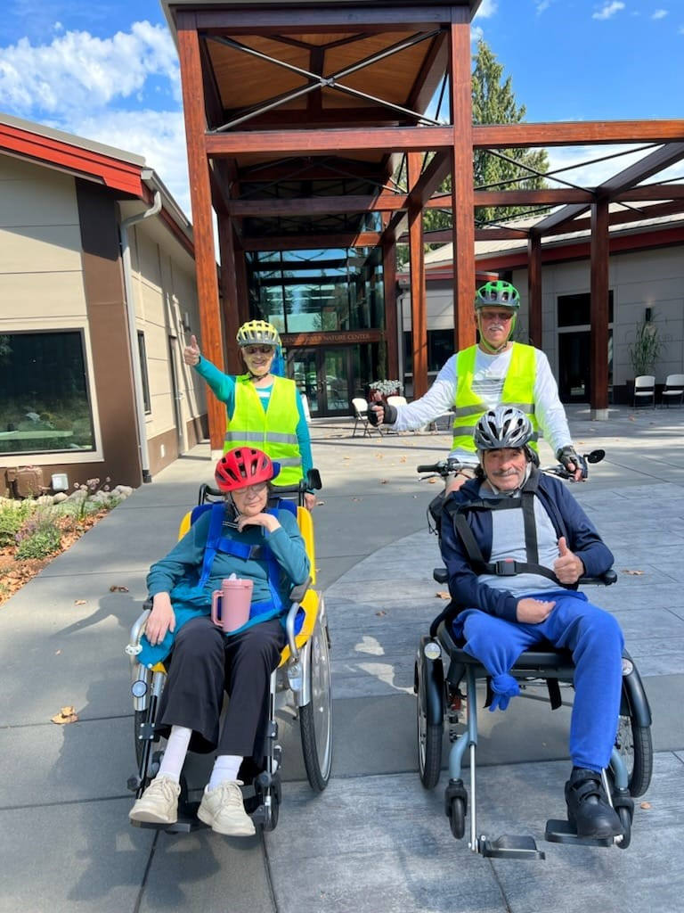
Rules of the Road Highlights #3
When passing, use the bike bell or common, succinct language (e.g., “Bicycles on Your Left” , “Coming through” or in emergent situations “Heads Up” or “Hey!”).
The Board approved a formal rule prohibiting riding on West Hendrickson Road, with or without wheelers, between Priest Road and the Nature Center except when there is construction on the Olympic Discovery Trail.
Point of emphasis this season is for fast approaching bikes from the rear … all bikes have mirrors … if the Safety or Pilot are aware of a bike coming from the rear, call out “bike back” to make everyone in the POD aware.
Stalwart Volunteers Eric & Kathy Mahnerd

Slide 17
Frequently Asked Questions (cont.)
What if I am unable to go on a ride I signed up for?
Please let your Ride Leader know and try to find a replacement
What about windy, chilly, or rainy days for riding?
When the wind is strong, it’s raining or air quality is bad, it is both unsafe to ride and uncomfortable for the Wheelers. The Ride Leader will call/discuss with the facility and decide if the ride is to be cancelled
When should we meet at the shed to prepare for a ride?
The time listed on SignUp Genius is your arrival time at the shed for the ride

Slide 18
Frequently Asked Questions (cont.)
What about the weights?
Weight bags MUST be used when riding the Duet (if used) and Opair bikes to/from the River Center (or location pick-up) without a Wheeler. The Fun2Go, Trishaw, Chat and VeloPlus do not need weights
At end of ride, remove weights from bike seats (preserves integrity of seat cushion)
What about waivers?
Every person on a ride (Volunteers, Wheelers and family member if joining the ride) must have signed a waiver. The Ride Leader will confirm with the facility that the waivers are up to date

Slide 19
Frequently Asked Questions (cont.)
If there are two Wheelers, where should the Safeties ride?
One Safety rides in front and the other in the back of the Pod to announce people/cyclists approaching from front or rear. If there is a third Safety, they will in the middle, or at times along side of the Pod (if trail allows)
1 Safety for two bikes, 2 for three bikes, 2 (minimum ideally 3) for 4 bikes, 3 for five bikes
The Safety checks on the well-being of the Wheeler (seating, blanket and helmet positioning, etc.). If anything needs adjustment, stop the ride and make the adjustments
The Safeties will use their voice (and/or bell) and hand signals to alert POD and others on the trail of their approach and to let Pilots know of approaching bikes from the rear
See also “Safety’s Responsibilities” for additional information.

Slide 20
Frequently Asked Questions (cont.)
What if I know of someone who wants to ride with us?
Direct them to the website to fill out a ride request and waiver form
How do we deal with a caregiver or a family member riding along?
Caregivers, friends, or family members who ride along must sign a waiver
Helmets are required. Bring extra helmets on the ride
It’s best/most safe for them to ride in back of rather than alongside the Wheeler. This should be communicated with them before the ride begins
Please advise them NOT to use cell phones while riding. If they need to talk on the phone, they are to stop riding and catch up later with the group

Slide 21
Frequently Asked Questions (cont.)
What if you as a volunteer feel there is an unsafe situation?
Please express your concern to the Ride Leader. It is their responsibility to make sure that ALL feel safe on the ride
How long do the rides last?
Rides are scheduled for one hour unless otherwise noted on SignUp Genius. This includes greeting the Wheelers, getting them settled on the bikes and returning to the drop-off location

Slide 22
Frequently Asked Questions (cont.)
What about getting off the bike and pushing it in a difficult situation?
YES!!! By all means do this when necessary or if you have any doubts
If you cannot bypass a dangerous area/situation (i.e. a pronounced tree root, a very steep or slanted area), stop, assess the situation and determine the safest route to take. This might mean getting off and pushing the bike
NOTE: Certain parts of the Trail have tree roots, uneven surfaces, inclines and downhills, blind turns and narrower parts. Ride SLOW in these areas. These will be pointed out to you on your rides

Slide 23
Frequently Asked Questions (cont.)
When the bike is in a stopped position, it may be difficult to get it going again, PLEASE do not force the pedals. Remember you must be pedaling to shift gears. Alert the Ride Leader or Safety if you need help. You may need to get off the bike and push OR while the bike is stopped enlist help of another volunteer who when they raise the rear wheel, pedal and down shift the gears while rotating the pedals.
Remember to Downshift, Downshift, Downshift before stopping or even slowing down. This will help prevent difficult starts. Remember to leave the bike in a low gear (1 or 2) when stopping, getting off, as well as before entering and storing the bike in the Shed for the next ride.

Slide 24
Frequently Asked Questions (cont.)
What do I do if something does not seem right or works correctly, or hear an unusual noise?
It is important to stop, perhaps get off the bike and see what is causing the problem instead of trying to muscle through it. Alert the Ride Leader. STOP, OBSERVE, ASSESS
What if there is a Medical Emergency?
We follow the “Good Samaritan Law” to rescue (first aid, CPR, call 911). This protects all of us from liability if unintended consequences result from our assistance. We are not medical professionals. The Ride Leader will alert the facility contact

Slide 25
Frequently Asked Questions (cont.)
What if the Pilot or Safety is hard of hearing?
Please communicate this to the ride team, including the Wheeler. Consider establishing a hand signal system for communicating with each other before you begin riding. Pilots and Safeties may also use bicycle hand signals
What if the Wheeler is non-communicative?
The Safety should keep a close eye on the Wheeler. The Pilot or Safety may choose to stop occasionally to check in with the Wheeler face-to-face

Slide 26
Frequently Asked Questions (cont.)
What if it starts raining on the ride?
For safety reasons, rides are cancelled if it starts to rain. The Ride leader will alert the facility contact and direct bikes to return to the drop off location. Bike bags have ponchos that can be given to the Wheeler
How do we deal with dogs and horses on the trail?
The Safety will go ahead, communicate with pet owners about oncoming bikes and then communicate with the Pilot (i.e. “Safe to go” or “Proceed with caution”). If a horse rider is encountered, it is advised to stop and talk to the rider as they approach

Slide 27
Frequently Asked Questions (cont.)
What is the Ride Log?
The Ride Log is our accurate record of the rides. The Ride Leaders are responsible for filling out the ride log, then text/email to Bob Fitton
Who is responsible for communicating with the ride team before the ride?
The Ride Leader will be in communication with the Facility, Pilots/Safeties. The Ride Leader is listed on SignUp Genius

Slide 28
Frequently Asked Questions (cont.)
What is our policy concerning COVID?
As of March 2024, the CDC has updated Covid-19 recommendations. Any Volunteer / Wheeler who is sick/not feeling well should stay home. Please use common sense
NOTE: cold like symptoms can be Covid or one of a number of respiratory viruses; both put our Wheelers and Volunteers at risk. The Ride Leader will emphasize this safety precaution with the Activity Director when setting up a ride
Anyone who has tested positive for Covid-19 no longer needs to stay in isolation for 5 days. You may return to normal activities if symptoms are mild and improving and have been fever- free, without use of fever-reducing medication, for at least 24 hours

Slide 29
Frequently Asked Questions (cont.)
Do we ride on days with Air Quality Alerts?
The Ride Leader and Facility/Activity Director will evaluate air quality and make a decision as to wheter or not the ride will be conducted. If the ride is cancelled, the Ride Leader will notify the volunteers of this decision

Slide 30
Interpersonal Skills
SPECIFIC NEEDS
  The Ride Leader will ask the Activity Director, family member or caregiver before the ride if there is anything specific to know while out riding, a particular behavior or condition, etc.
  If a Wheeler experiences anxiety, vertigo or other behavior/symptoms of concern, stop, alert the Ride Leader and have a face-to-face conversation. Assure them that they are safe and make them feel comfortable. Continue the ride slowly. If the Wheeler continues to feel uncomfortable, the Ride Leader will determine whether to continue the ride or return to drop-off location
  If you view/experience unusual behavior and are not quite sure how to deal with it, please share your concerns with your Ride Leader. The Ride Leader will decide whether to contact the activity director, family member or caregiver for advice

Slide 31
Interpersonal Skills (cont.)
LESS IS MORE
  Stress and/or anxiety can occur when too many people assist with seatbelt, footrest, helmet, blanket, etc. The Pilot and Safety should introduce themselves and then one or the other should get the Wheeler ready for the ride (preferably of the same gender)
  Use short, clear sentences. “May I help you with the footrest?” “Would you like a blanket, water?” Even if the Wheeler is nonverbal, this makes a difference

Slide 32
Memory Loss
People with memory loss may suddenly not recognize you or their surroundings. They might wonder, “Who are these strangers?” “Where am I?”
They may experience anxiety, feel overwhelmed and/or feel overstimulated. In this situation, it is especially important to remember that less is more. Avoid long, complicated explanations or sentences. Quietly and calmly explain who you are, that you are going for a 45 to 60 minute bike ride, that they are safe, and that you will bring them back after the ride.
It’s okay to stop, face the Wheeler and repeat these things again during the ride.
Mentioning something familiar may help as well, such as the name of a spouse, or the Activity director.

Slide 33
Memory Loss (cont.)
Use age-appropriate conversations. Always assume that the Wheeler understands you unless you know differently. Act with respect
If all else fails and the Wheeler is still scared, appears anxious, or is simply not enjoying the ride, call for a stop and alert the Ride Leader. If the Wheeler is not enjoying the ride, it may be best for all to return to the drop off location. If the decision is made to return to the drop off location, the Ride Leader will contact the Activity Director.
It is important to consider BOTH MENTAL AND PHYSICAL COMFORT
IF THERE IS A LIFE THREATENING EMERGENCY – Call 911

Slide 34
How to Sign Up for Bike Training Sessions
You will receive an email to sign-up for each of the 3 training sessions via SignUp Genius … there will be a variety of dates and times to choose from.
You must complete all 3 training sessions before signing up for regular in-season rides (hopefully starting Memorial Day Monday May 25th).
If you have difficulties with SignUp Genius, please call or text Bob Fitton (253) 670-8276 or email bob.sequimwheelers@gmail.com.
You’re welcome to ride your own bike with the Sequim Wheelers for the annual Irrigation Festival Parade on Saturday May 9, 2026 even if you have not completed all three sessions of new volunteer training (save the date!).

Slide 35
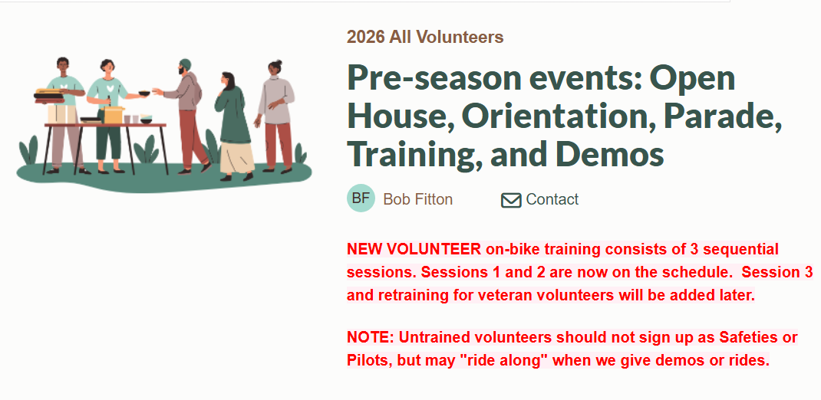
SignUp Genius Home Page

Slide 36
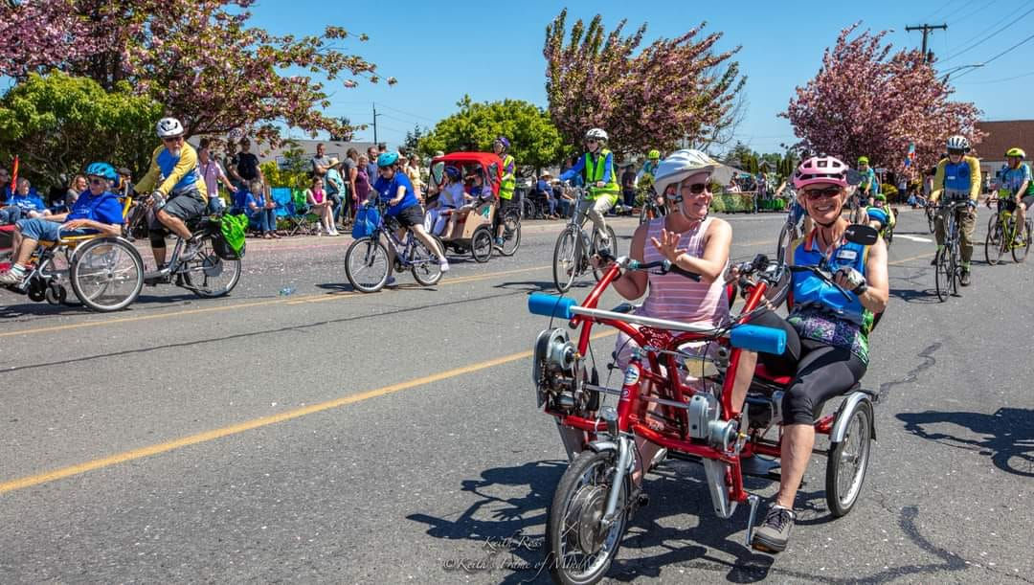
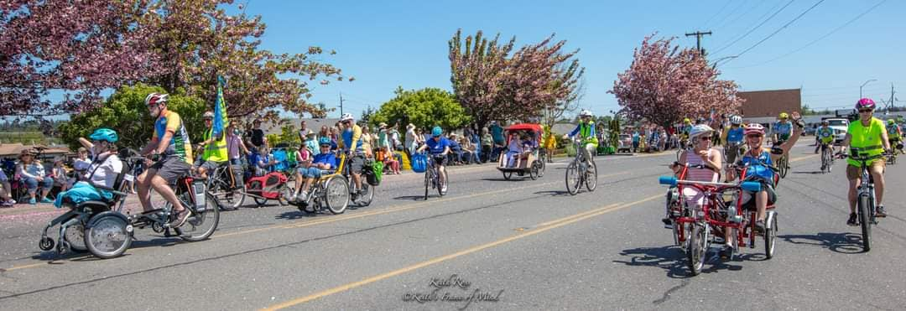
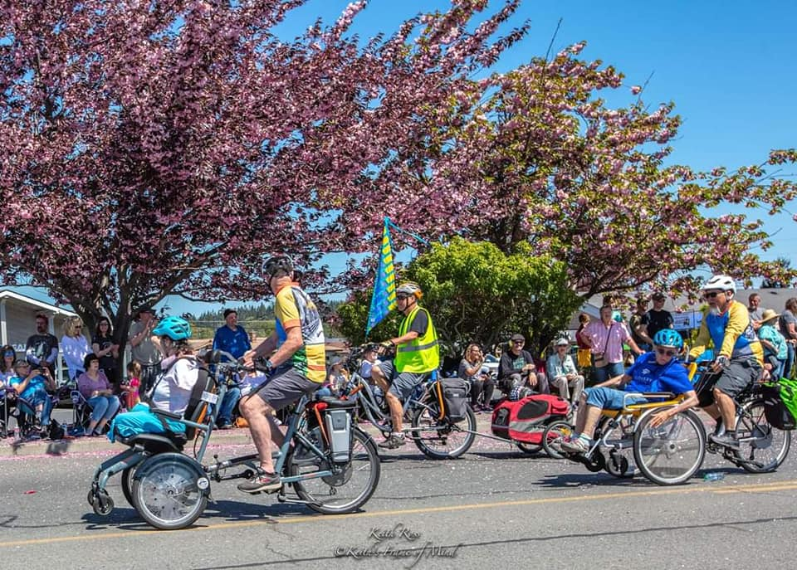
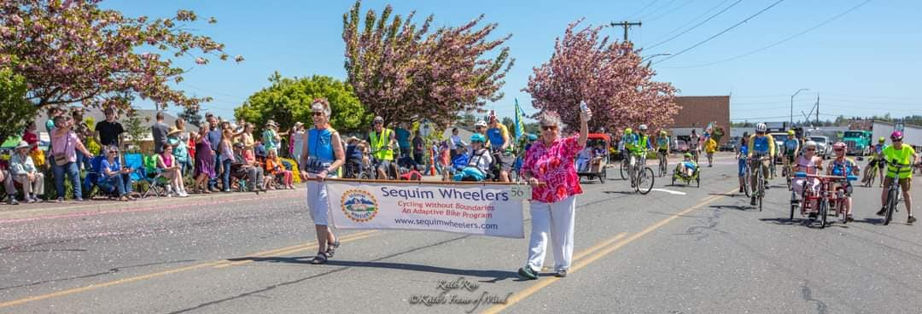
Irrigation Festival Parade - May 9, 2026

Slide 37
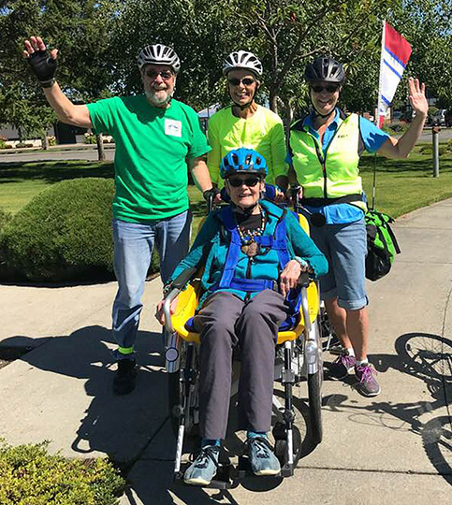
Keep Informed
Monthly Newsletters throughout the Season
Facebook www.facebook.com/Sequimwheelers
Website sequimwheelers.com
Thank You
Future Pilot & Safeties
See you Soon!

